Slide 1
COMPUTER VISION AND DEEP LEARNING
LECTURE 8

Slide 2
Supervised. Unsupervised. Self-supervised learning
SUPERVISED LEARRNING: models are trained on a dataset that includes both input data and corresponding labels
Imagenet labelling (Amazon Mechanical Turk)
Labelling started in July 2008 and ended in April 2010
It took 49K workers from 167 countries filtering and labelling over 160M candidate images
Each of the 14 million images labelled three times.
UNSUPERVISED LEARNING: analyses unlabelled datasets to identify hidden patterns, structures, or relationships without human intervention
SELF-SUPERVISED LEARNING: system learns to understand and interpret data by teaching itself

Slide 3
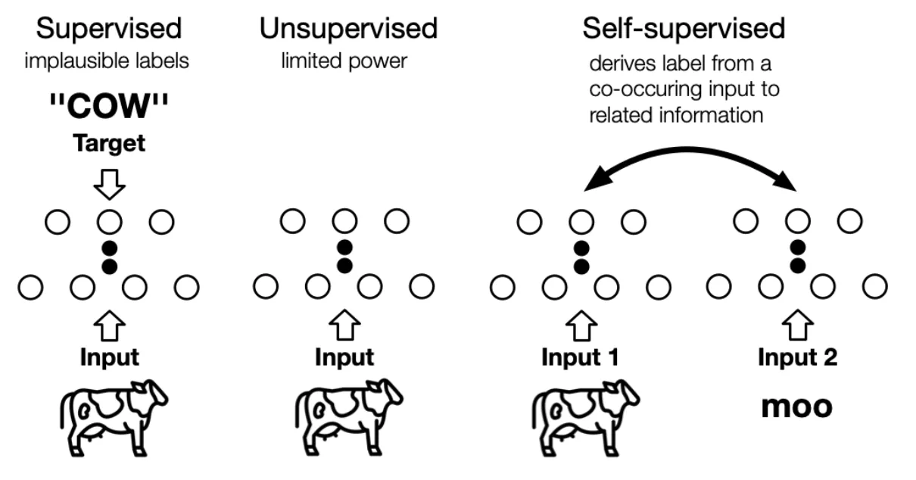
Supervised. Unsupervised. Self-supervised learning

Slide 4
Self-supervised learning
Define a pretext task that generates supervisory signals from the data itself
The network learns representations by solving the pretext task, and these representations transfer to downstream tasks
Idea: if a model can predict missing or transformed parts of data, it learned something meaningful about the data's structure.

Slide 5
Self-supervised learning
Contrastive learning
Self-distillation
Masked image modeling (MIM)

Slide 6
Self-supervised learning
Contrastive learning
pull together representations of different views of the same image (positives), push apart representations of different images (negatives)
learn “same” vs “different” representations
The typical loss is InfoNCE: softmax cross-entropy where the positive pair is the correct class and all negatives are incorrect classes

Slide 7
Self-supervised learning
Contrastive learning
Self-distillation
usually, use two views of the same image and train the model such that their representations match
NO is no explicit push-apart force on negatives
Masked image modeling (MIM)

Slide 8
Self-supervised learning
Contrastive learning
Self-distillation
Masked image modeling (MIM)
The model receives an image with parts removed and must predict the missing content
Reconstructive learning signal: the model must understand enough about visual structure to fill in the gaps

Slide 9
Contrastive learning
Momentum Contrast for Unsupervised Visual Representation Learning (MoCO)
https://arxiv.org/pdf/1911.05722

Slide 10
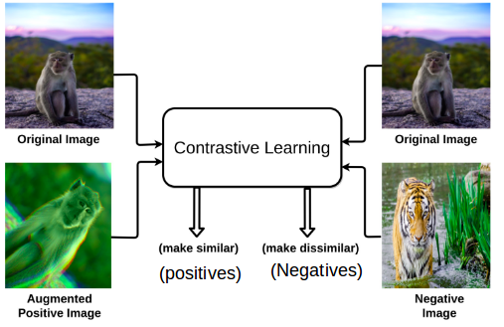
Contrastive Learning

Slide 11
Contrastive learning (CL)
Pull representations of two augmented views of the same image together, push representations of different images apart
The model solves a discrimination task: given a query, identify its matching key among a set of distractors.
Works if distractors are hard enough
E.g. K negatives drawn randomly from ImageNet's ~1000 classes, K needs to be large enough that most classes appear at least once in the negative set.
At K=256 -> many classes are absent and the task is underspecified

Slide 12

InfoNCE (Noise Contrastive Estimation) loss
Frames representation learning as a K+1-way classification problem
Given a query q, one positive key k⁺ (another view of the same image), and K negative keys k₁…k_K (views of different images), the loss classifies which key is the positive

Slide 13
InfoNCE loss
Frames representation learning as a K+1-way classification problem
Given a query q, one positive key k⁺ (another view of the same image), and K negative keys k₁…k_K (views of different images), the loss classifies which key is the positive
Minimizing this loss simultaneously maximizes the similarity between query and positive and minimizes similarity between query and all negatives

Slide 14
Contrastive learning
CL can be seen as building a discrete dictionary over a on high-dimensional continuous input (images)
Dynamic dictionary:
keys are randomly sampled
key encoder evolves during training
Hypothesis: good features can be learned by a large dictionary that covers a rich set of negative samples, and the encoder for the dictionary keys is kept as consistent as possible despite its evolution

Slide 15
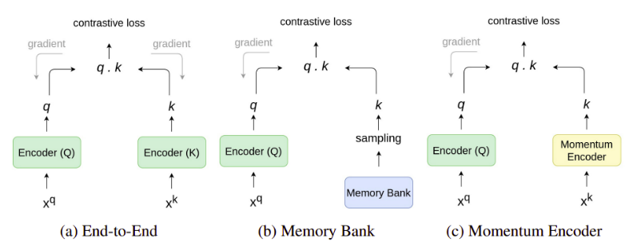
Patterns in contrastive learning

Slide 16
Patterns in CL End to end
Uses the samples in the current mini-batch as the dictionary, so the keys are consistently encoded
The model needs a very large batch size of negative samples which is memory expensive

Slide 17
Patterns in CL Memory bank
A memory bank contains the feature representation for all images in the dataset
Feature representations for each image are exponential moving average calculated in prior epochs
The memory bank needs to be updated and replaced
Drawback: it needs to regularly update the feature representations in the memory bank which can be computationally expensive.

Slide 18
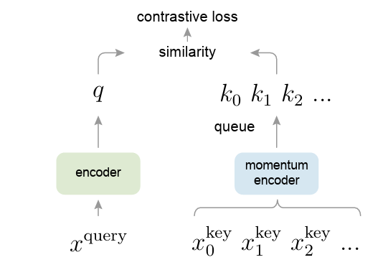
Patterns in CL Momentum encoder. MoCo
Dictionary is maintained as a queue of samples -> allows the reuse of keys in the immediate preceding mini-batches
Dictionary can be much larger than the typical mini-batch size
Samples in the dictionary are progressively replaced: enqueue the current mini-batch and remove the oldest one
Oldest keys are most outdates and less consistent with the newer ones

Slide 19

MoCo
Queues can increase the size of the dictionary, but keys update becomes intractable with backprop (the gradient should flow to all samples in the queue)
Use momentum update
Only θ_{q} is updated by backprop. θ_{q} evolves more smoothly (keys in the queue are encoded by different encoders – different mini-batches – their difference is not that big)
Use a large momentum m = 0.999

Slide 20
MoCo Pretext task
a query and a key are a positive pair if they originate from the same image, and otherwise as a negative sample pair
Take two random “views” of the same image under random data augmentation to form a positive pair
The data augmentation setting: a 224x224-pixel crop is taken from a randomly resized image, and then undergoes random color jittering, random horizontal flip, and random grayscale conversion
Queries and keys are encoded by two different encoders f_{q} and f_{k}

Slide 21
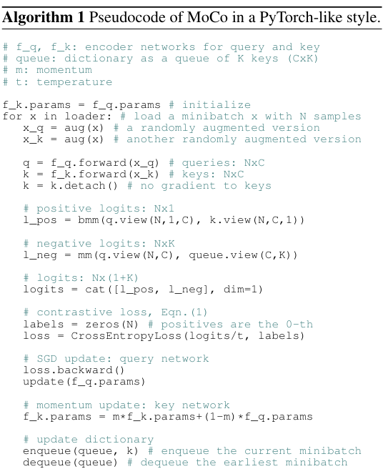
Key encoder starts as an exact copy of the query encoder.

Slide 22
Two independent random augmentations of the same batch. x_q and x_k look different but contain the same images. One will produce the query, one the positive key.

Slide 23
FW pass. N – images, C – dimensionality each
Cut the gradient through the key encoder

Slide 24
Batched matrix multiply between query and its corresponding positive key
q.view(N,1,C) -> (N, 1, C)
k.view(N,C,1) -> (N, C, 1)
The bmm result shape: (Nx1x1) -> (Nx1)
Each of the N images gets one scalar: the dot product between its query and its own positive key.
High value = good alignment.

Slide 25
Matrix multiply between all queries and all queued keys.
Shape: (NxC) · (CxK) = (NxK). K queue size
Every query is compared against every key in the queue.

Slide 26
Concatenate positive and negative logits along the key dimension
Shape: (N x (1+K))
The positive is at index 0

Slide 27
labels -> the correct answer is always at index 0 (the positive).
logits/t -> apply the temperature before the softmax inside CrossEntropyLoss.
Low t sharpens the distribution and focuses gradients on hard negatives

Slide 28
Gradients flow only through the query encoder. f_k was detached. Only f_q's parameters are updated.
EMA update of the key encoder
m = 0.999
f_k slowly and consistently evolving, to prevent the inconsistency that would occur if f_k changed as fast as f_q

Slide 29
FIFO queue update.
The N fresh keys from this batch are added to the front, and the N oldest keys are removed from the back.
The queue always holds exactly K keys, all produced by recent versions of f_k. MoCo gets 65536 negatives at batch size 256 and queue size the 256 previous batches

Slide 30
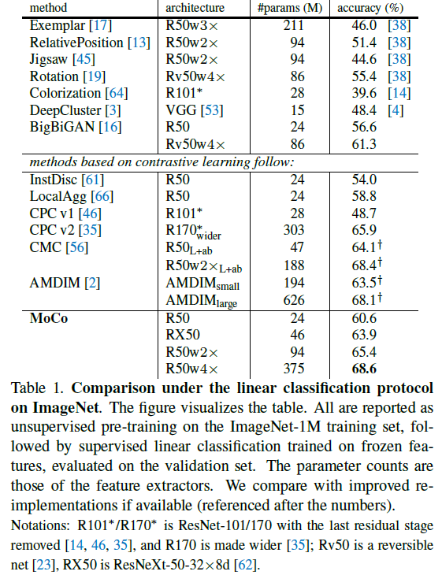
MoCo Results

Slide 31
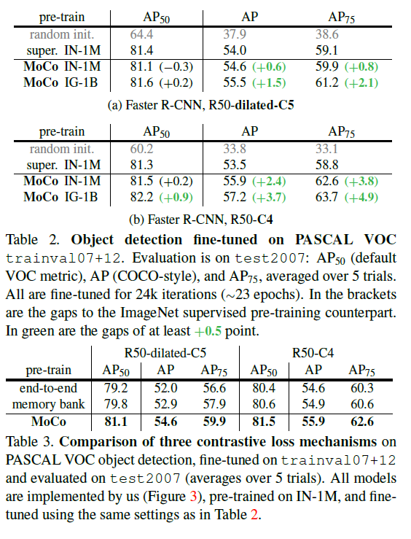
MoCo Object detection

Slide 32
MoCo
MoCo -> a strong pretrained backbone but doesn’t require afford the large-batch compute as other CL methods
The contrastive objective directly optimizes instance discrimination, each image gets a unique identity in the embedding space -> MoCo features well-calibrated for distance-based tasks
Use MoCo for image retrieval and similarity search, where cosine similarity between features is meaningful
MoCo falls short at dense prediction. The final global average pool vector captures what is in the image but not where.

Slide 33
Self-distillation
Emerging Properties in Self-Supervised Vision Transformers (DINO)
https://arxiv.org/abs/2104.14294

Slide 34



DINO Knowledge distillation (KD)
Knowledge distillation is a learning paradigm in which a student network g_{θs} is trained to match the output of a given teacher network g_{θt}
Ps(x) and Pt(x), student and teacher predicitions (probabilities) for an image x
Given a fixed teacher network g_{θt} , DINO learns to match the student and teacher distributions by minimizing the cross-entropy loss w.r.t. the parameters of the student network g_{θs}

Slide 35
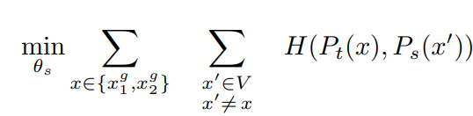
DINO KD as self-supervised learning
For an image x, generate a set V of different views construct different distorted views, or crops, of multicrop strategy
two global views, x_{g}¹ and x_{g}² (224² covering > 50% of the image)
several local views of smaller resolution (96² covering smaller areas, < 50% of the image)
All crops are passed through the student
Only the global views are passed through the teacher
This encourages learning “local-to-global” correspondences
Given a different crop of the image, can the student predict what distribution the teacher produces?

Slide 36

DINO Teacher and student networks
Teacher and student share the same architecture with different sets of parameters θ_{s} and θ_{t}
NN g is composed of a backbone f (ViT or ResNet ), and of a projection head h: g = h ◦ f.
The projection head consists of a 3-layer MLP with hidden size 2048, and a weight normalized fully connected layer
In downstream tasks use only the backbone f output.
Does not use BN in ViT
TEACHER
Unlike classical KD, the teacher does not exists a priori and is build it from past iterations of the student network
Use an exponential moving average (EMA) on the student weights:

Slide 37
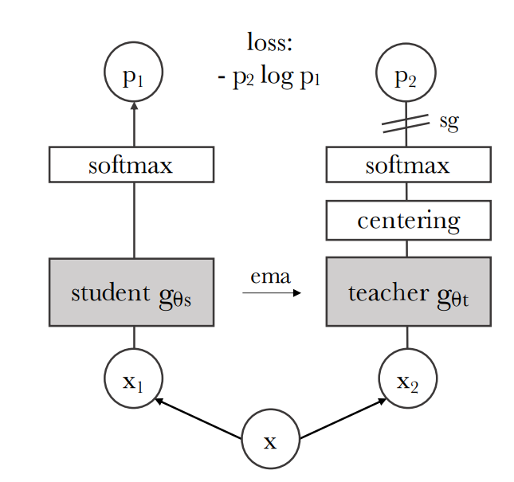
DINO
EMA teaches gt ← λ·gt + (1−λ)·gs λ goes from 0.996 tp 1 during training.
Teacher is a stable moving target.
The student must predict the teacher's distribution from a different crop. Same-view pairs are never used.
-> view-invariant, semantic representations

Slide 38

DINO
COLLAPSE: trivial optimal solution is for both networks to output the same constant distribution
Centering: subtract running mean c from teacher logits
Prevents one dimension to dominate, and has a uniformization effect (B batch size)
Sharpening: low teacher temperature
Opposite effect of sharpening

Slide 39
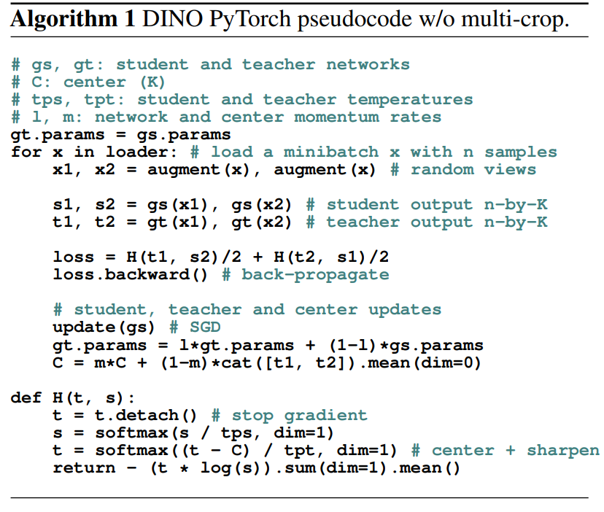
DINO

Slide 40
x1, x2 - two different random views
With multi-crop (full DINO), the student also sees several small local crops. The teacher only ever sees the two global views.
Teacher saw view 1. Student saw at view 2. The student must predict the teacher's distribution from a completely different crop. Student to learn that both crops, despite looking different, belong to the same semantic concept.

Slide 41
Teacher starts as an exact copy of the student

Slide 42
Standard SGD step on the student only.
No gradient update of the teacher here
EMA update of the teacher. This is the only way the teacher can change

Slide 43
EMA update of the center C
cat([t1, t2]) stacks - teacher outputs from both views into shape (2n, K). .mean(dim=0) averages across all 2n samples -> shape (K,)
C tracks the running mean of teacher outputs across the dataset

Slide 44
Converts student logits to a probability distribution. Higher temperature, softer distribution. Student is mor uncertain

Slide 45
1. Centering: subtract the running mean c. Removes whatever prototype the teacher always favors regardless of input (prevents mode collapse)
2. Sharpening: divide by teacher temperature much lower than student's 0.1 -> sharper distribution.
forces the student to make confident predictions, which prevents uniform collapse

Slide 46
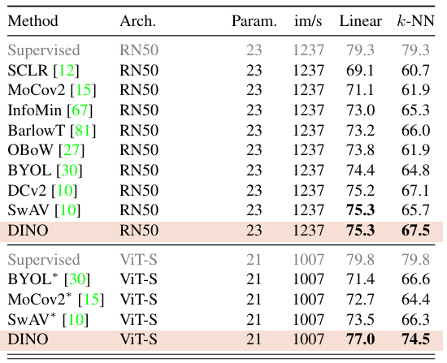
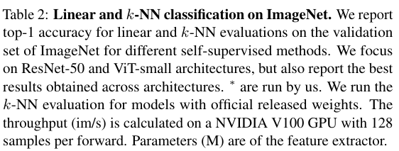
DINO Results

Slide 47
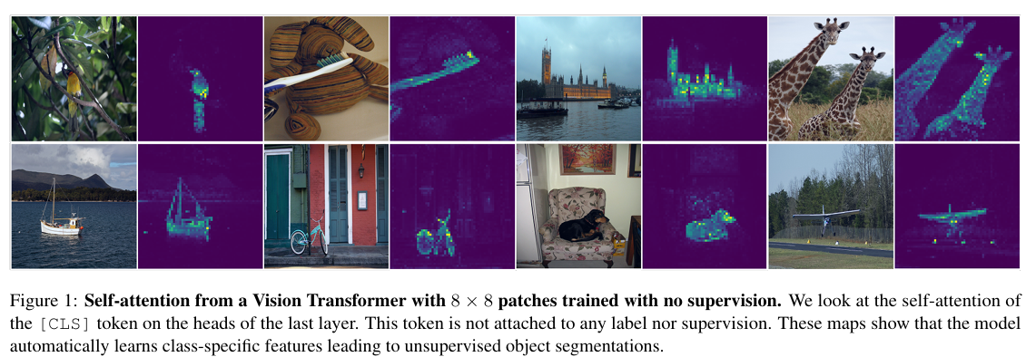
DINO Properties

Slide 48
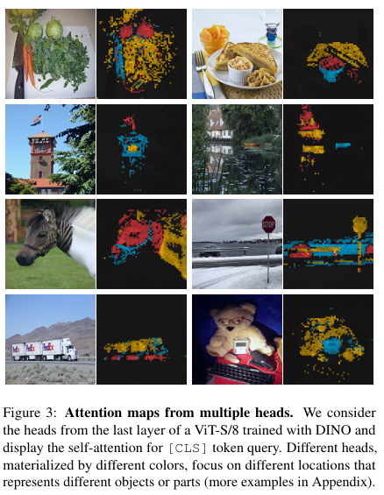
DINO Properties

Slide 49
DINO
DINO produces qualitatively different features -> the self-distillation objective encourages the [CLS] token to aggregate spatially and semantically coherent info from across the image.
Use DINO when you need frozen features that work immediately
DINO -> the quality of its frozen representation
Use it for segmentation without finetuning, where patch-level attention maps trace object boundaries as an emergent property
Use it for video object segmentation, where patch features are geometrically consistent enough across frames that temporal correspondence appears for free via nearest-neighbor matching.
DINO -> overkill is full finetuning on classification

Slide 50
Masked Image Modelling
Masked Autoencoders Are Scalable Vision Learners
https://arxiv.org/abs/2111.06377

Slide 51
MAE
Success of masking in NLP (BERT)
What makes masked autoencoding different between vision and language?
For a time, architectures were different: transformers vs CNNs
Information density is different between language and vision.
Language: highly semantic and information dense
Images: exhibit high redundancy. A missing patch can be recovered from neighboring patches with little high-level understanding
Decoder plays a different role
Images: reconstructs pixels, its output is of a lower semantic level than common recognition tasks.
Language: it predicts missing words that contain rich semantic information.

Slide 52
MAE
IDEA: mask random patches of the input image and reconstruct the missing pixels
Asymmetric encoder-decoder architecture
encoder operates only on the visible subset of patches
a lightweight decoder that reconstructs the original image from the latent representation and mask tokens
Masking a high proportion of the input image, e.g., 75%, yields a meaningful self-supervisory task.

Slide 53
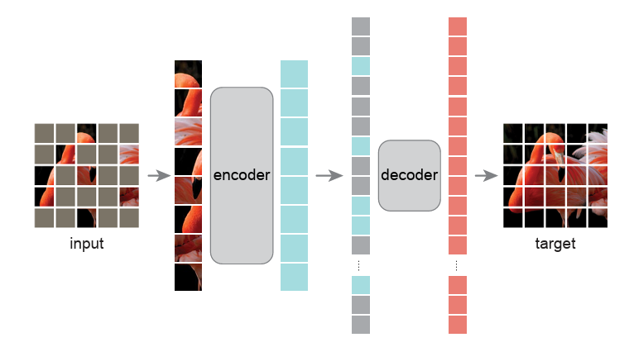
MAE

Slide 54
MAE Encoder
Divide an image into regular non-overlapping patches
Sample random patches without replacement following a uniform distribution
High masking ratio (i.e., the ratio of removed patches) eliminates redundancy

Slide 55
MAE ENCODER
ViT applied only on visible, unmasked patches
Only operates on a small subset 25% of the patches
Mask patches are removed
Can train large encoders, with only a fraction of compute and memory
Uses positional embeddings

Slide 56
MAE DECODER
Processes the full set of tokens consisting of
encoded visible patches
mask tokens
Mask token: shared, learned vector that indicates the presence of a missing patch to be predicted
Add positional embeddings to all tokens in this full set to ensure mask tokens have no information about their location in the image
Only used during pre-training to perform the image reconstruction task
Independent of the encoder design

Slide 57
MAE Reconstruction target
MAE predicts the pixel values for each masked patch.
Each element in the decoder’s output is a vector of pixel values representing a patch.
Last layer: a linear projection whose number of output channels equals the number of pixel values in a patch.
The decoder’s output is reshaped to form a reconstructed image.
Loss: MSE between the reconstructed and original images in the pixel space

Slide 58
MAE Efficient implementation
Generate a token for every input patch (by linear projection with an added positional embedding)
Randomly shuffle the list of tokens and remove the last portion of the list, based on the masking ratio -> small subset of tokens for the encoder (equivalent to sampling patches without replacement)
Encode tokens
Append mask tokens to the list of encoded patches
Unshuffle the full list (invert the random shuffle operation) to align all tokens with their targets
Decoder applied to this full list (with positional embeddings added).
No sparse operations are needed.

Slide 59
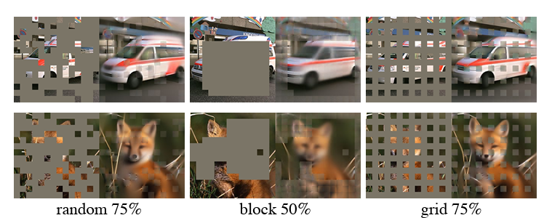
MAE Masking strategy
RANDOM: works best.
BLOCK: works reasonably well at a ratio of 50%, but degrades at a ratio of 75%. Harder task. Reconstruction is blurrier.
GRID: reconstruction is sharper. The representation quality is lower.

Slide 60

MAE ImageNet experiments

Slide 61
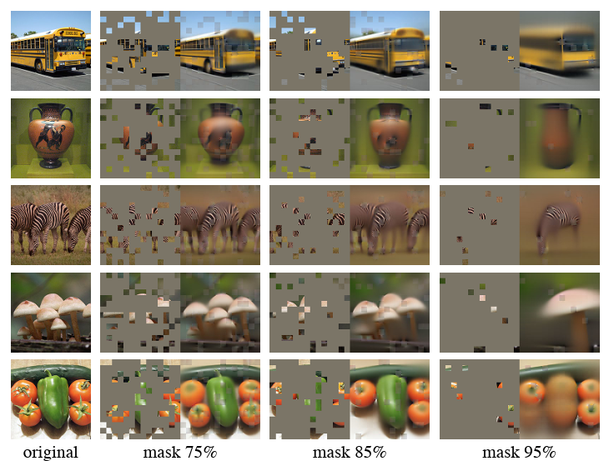
MAE Results on inputs with higher masking ratio

Slide 62
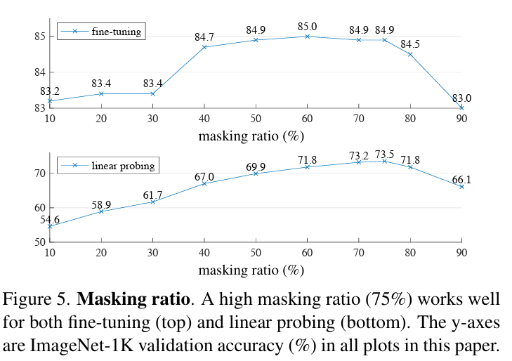
MAE

Slide 63
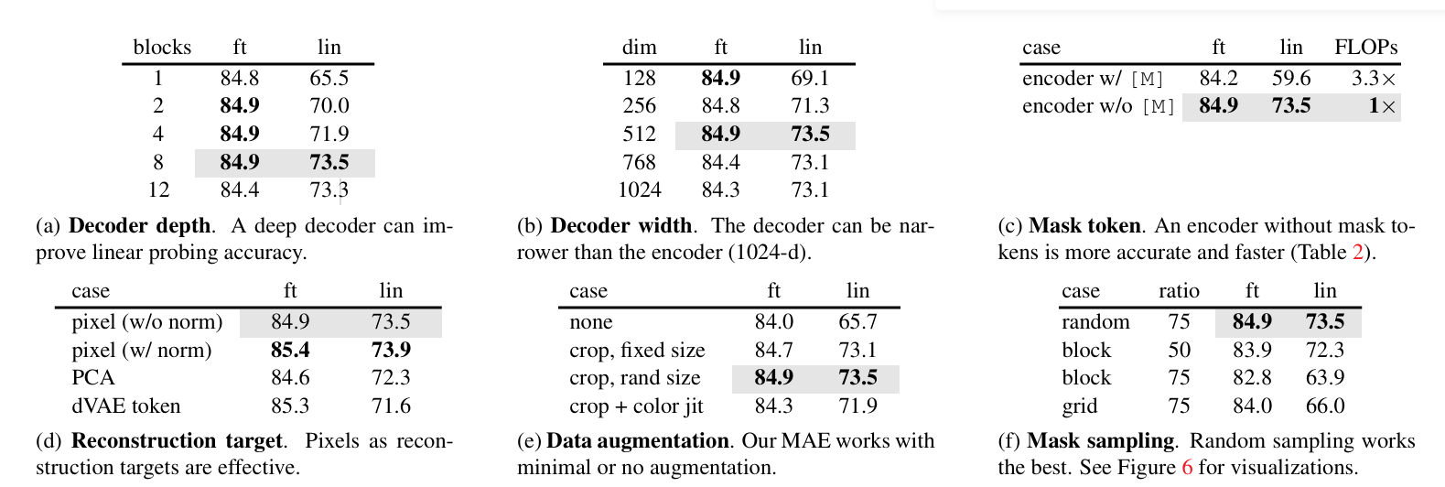
MAE

Slide 64
MAE
MAE is a reconstruction method - it masks 75% of the image patches and trains the model to fill them back in
learns how images are structured (textures, shapes, object parts) rather than learning to discriminate between images semantically
MAE frozen features are weaker
Do not use MAE when: you need frozen features, you need a plug-and-play backbone, or your task is pure classification without full finetuning
Use MAE when you have a large ViT, you plan to finetune it fully on a downstream task, and that task requires dense spatial predictions (detection, segmentation, depth)

